Slide 1
ICSL 여름학기 - 2
박준모

Slide 2
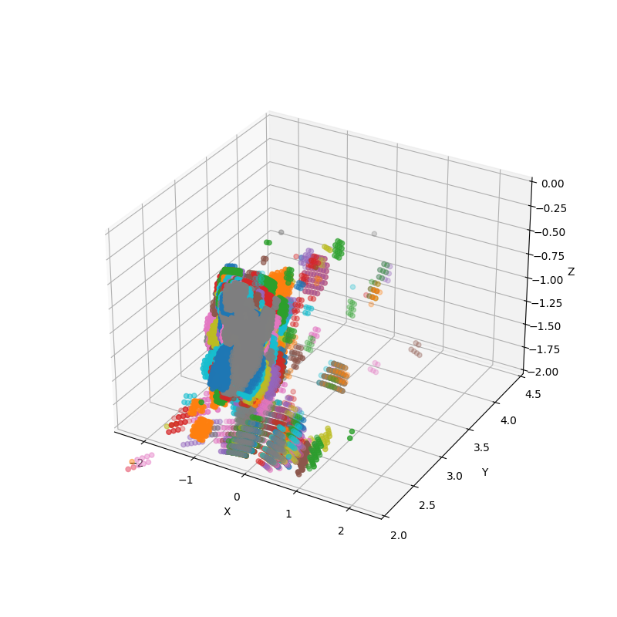
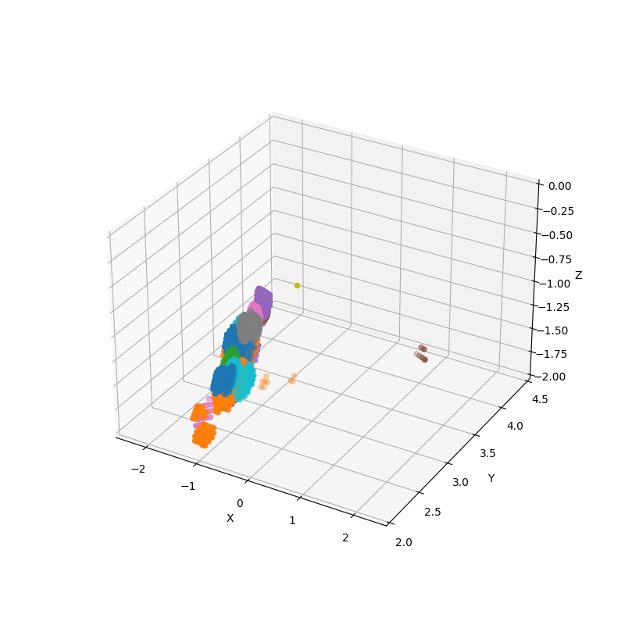
특징추출_golf
original
|velocity|>1

Slide 3
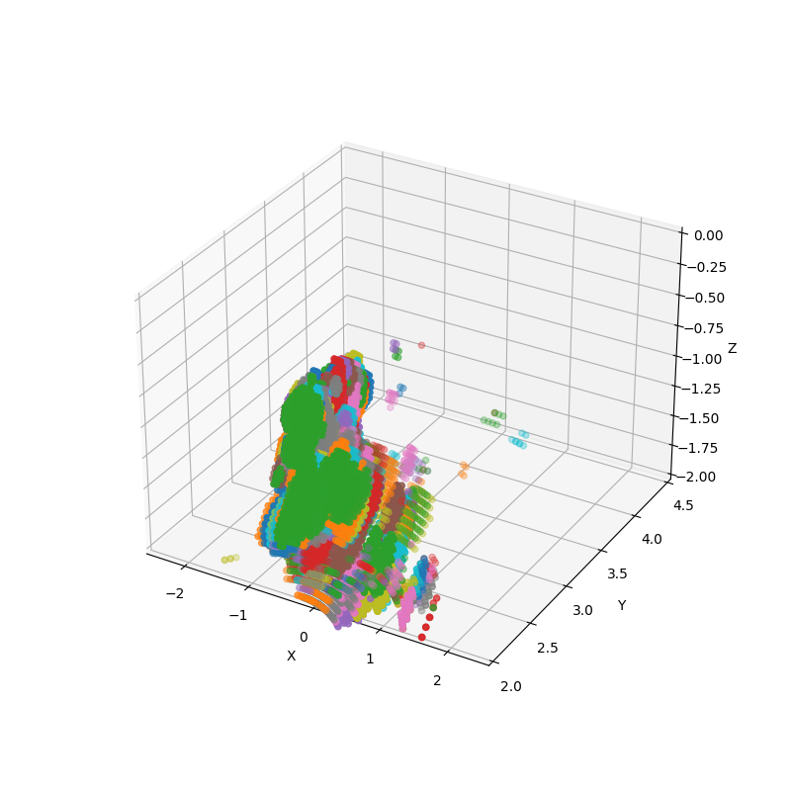
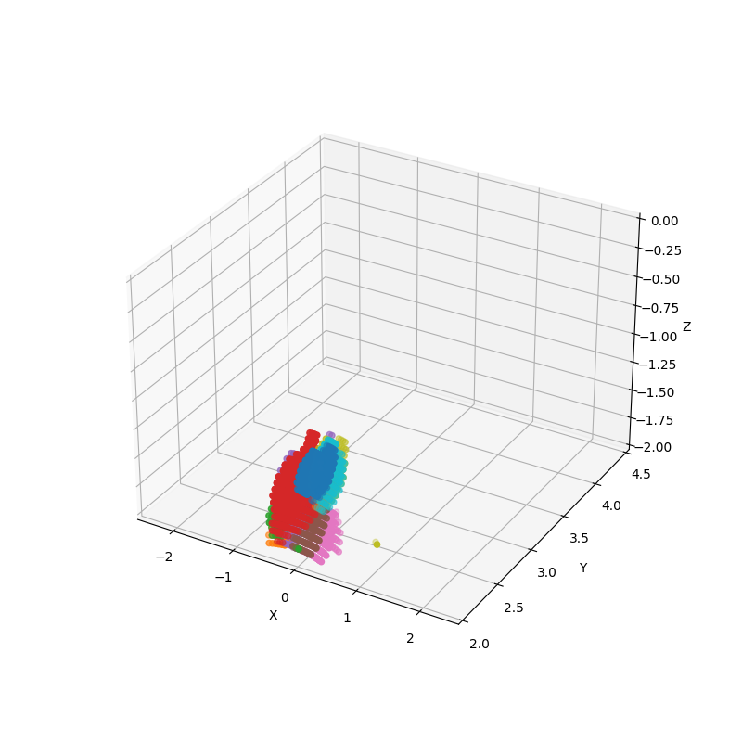
특징추출_soccer
original
|velocity|>1

Slide 4
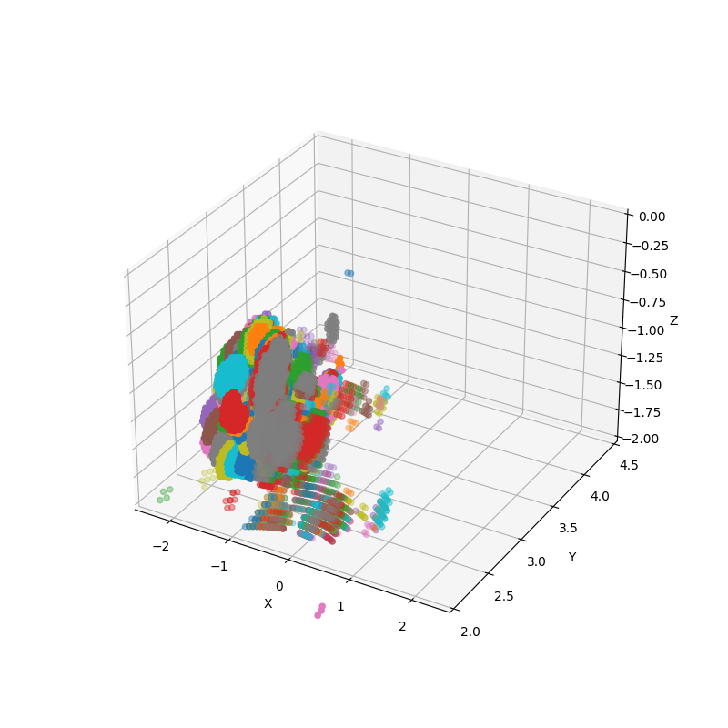
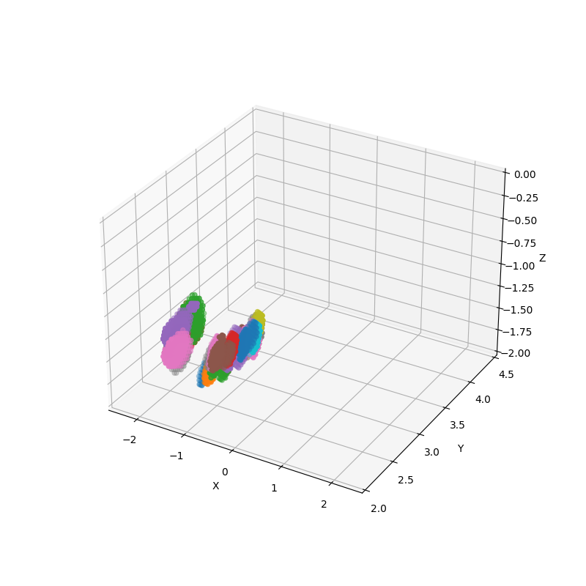
특징추출_tennis
original
|velocity|>1

Slide 5
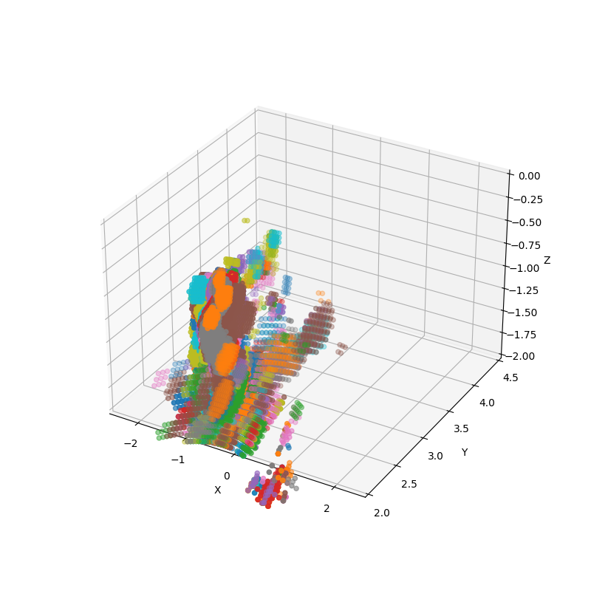
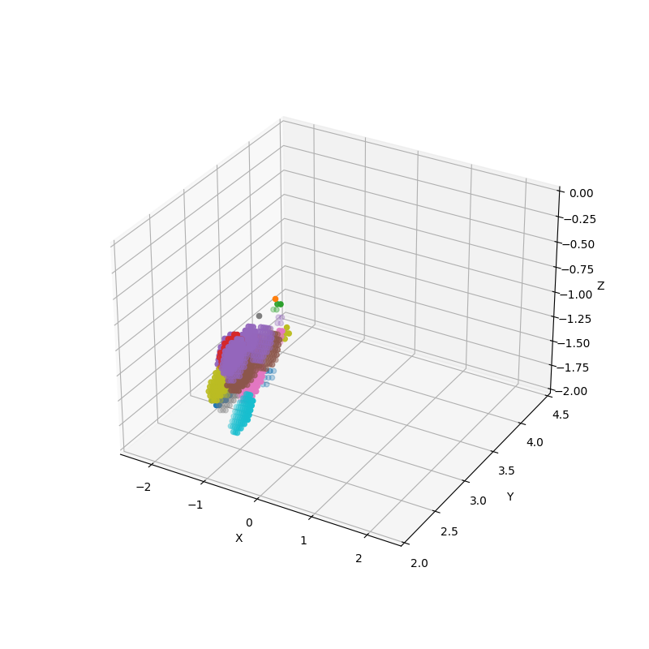
특징추출_valleyball
original
|velocity|>1

